Slide 1


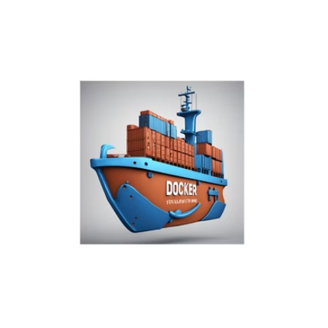

Introduction to Docker

Slide 2

Docker is an open platform for developing, shipping, and running applications.
Docker enables you to separate your applications from your infrastructure so you can deliver software quickly.
With Docker, you can manage your infrastructure in the same ways you manage your applications.
By taking advantage of Docker's methodologies for shipping, testing, and deploying code, you can significantly reduce the delay between writing code and running it in production.
The Docker platform
Docker provides the ability to package and run an application in a loosely isolated environment called a container. The isolation and security lets you run many containers simultaneously on a given host. Containers are lightweight and contain everything needed to run the application, so you don't need to rely on what's installed on the host. You can share containers while you work, and be sure that everyone you share with gets the same container that works in the same way.

Slide 3

Docker provides tooling and a platform to manage the lifecycle of your containers:
Develop your application and its supporting components using containers.
The container becomes the unit for distributing and testing your application.
When you're ready, deploy your application into your production environment, as a container or an orchestrated service. This works the same whether your production environment is a local data center, a cloud provider, or a hybrid of the two.
Understanding Virtualization and Containerization
Virtualization:
Virtualization is the process of creating a virtual version of something, such as a server, a storage device, a network, or even an entire operating system where the framework divides the resource into one or more execution environments.
Benefits of Virtualization:
Resource Efficiency: Better utilization of hardware resources.
Isolation: Each VM is isolated from others, reducing security risks.
Scalability: Easier to scale up and down based on demand.
Flexibility: Supports multiple operating systems on the same physical hardware.

Slide 4

Containerization
Containerization involves encapsulating an application and its dependencies into a container that can run on any computing environment. Containers share the host system’s OS kernel and isolate the application processes from other containerized applications.
Docker: One of the most popular containerization platforms. It automates the deployment of applications inside lightweight containers.
Kubernetes: An open-source platform for managing containerized applications across multiple hosts, providing basic mechanisms for deployment, maintenance, and scaling of applications.
Benefits of Containerization:
Lightweight: Containers share the host OS kernel, making them more lightweight than VMs.
Portability: Containers can run on any system that supports the container runtime environment, providing greater portability.
Consistency: Ensures that applications run the same regardless of where they are deployed.
Fast Boot-Up: Containers can start up quickly because they do not require booting up an entire OS.

Slide 5

Key Differences
Architecture:
Virtualization: Uses a hypervisor to create multiple VMs, each with its own OS.
Containerization: Runs containers that share the host OS kernel but isolate the application processes.
Overhead:
Virtualization: Higher overhead due to multiple OS instances.
Containerization: Lower overhead because containers share the host OS.
Performance:
Virtualization: Generally slower due to the additional layer of the hypervisor and multiple OS.
Containerization: Typically faster and more efficient due to shared OS and lightweight nature.
Resource Utilization:
Virtualization: Less efficient as it requires more resources to run multiple OS.
Containerization: More efficient as containers share the same OS and only encapsulate the application and its dependencies.

Slide 6

5. Use Cases:
Virtualization: Suitable for running multiple different OS on the same hardware, isolated environments for development and testing.
Containerization: Ideal for microservices architecture, continuous integration/continuous deployment (CI/CD) pipelines, and ensuring application portability across different environments.

Slide 7

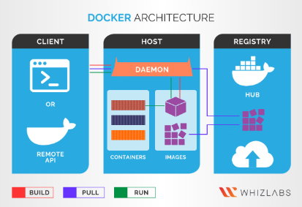
Docker architecture
Docker uses a client-server architecture. The Docker client talks to the Docker daemon, which does the heavy lifting of building, running, and distributing your Docker containers. The Docker client and daemon can run on the same system, or you can connect a Docker client to a remote Docker daemon. The Docker client and daemon communicate using a REST API, over UNIX sockets or a network interface. Another Docker client is Docker Compose, that lets you work with applications consisting of a set of containers.

Slide 8

The Docker daemon
The Docker daemon (dockerd) listens for Docker API requests and manages Docker objects such as images, containers, networks, and volumes. A daemon can also communicate with other daemons to manage Docker services.
The Docker client
The Docker client (docker) is the primary way that many Docker users interact with Docker. When you use commands such as docker run, the client sends these commands to dockerd, which carries them out. The docker command uses the Docker API. The Docker client can communicate with more than one daemon.
Docker Desktop
Docker Desktop is an easy-to-install application for your Mac, Windows or Linux environment that enables you to build and share containerized applications and microservices. Docker Desktop includes the Docker daemon (dockerd), the Docker client (docker), Docker Compose, Docker Content Trust, Kubernetes, and Credential Helper.

Slide 9

Docker registries
A Docker registry stores Docker images. Docker Hub is a public registry that anyone can use, and Docker looks for images on Docker Hub by default. You can even run your own private registry.
When you use the docker pull or docker run commands, Docker pulls the required images from your configured registry. When you use the docker push command, Docker pushes your image to your configured registry.

Slide 10

Docker objects
When you use Docker, you are creating and using images, containers, networks, volumes, plugins, and other objects
Images
An image is a read-only template with instructions for creating a Docker container. Often, an image is based on another image, with some additional customization. For example, you may build an image which is based on the ubuntu image, but installs the Apache web server and your application, as well as the configuration details needed to make your application run.
You might create your own images or you might only use those created by others and published in a registry. To build your own image, you create a Dockerfile with a simple syntax for defining the steps needed to create the image and run it. Each instruction in a Dockerfile creates a layer in the image. When you change the Dockerfile and rebuild the image, only those layers which have changed are rebuilt. This is part of what makes images so lightweight, small, and fast, when compared to other virtualization technologies.​

Slide 11
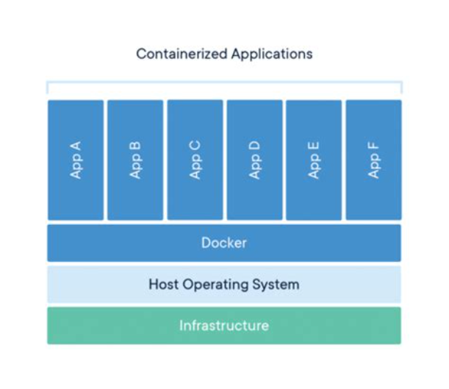
Containers

Slide 12

A container is a runnable instance of an image. You can create, start, stop, move, or delete a container using the Docker API or CLI. You can connect a container to one or more networks, attach storage to it, or even create a new image based on its current state.
By default, a container is relatively well isolated from other containers and its host machine. You can control how isolated a container's network, storage, or other underlying subsystems are from other containers or from the host machine.
A container is defined by its image as well as any configuration options you provide to it when you create or start it. When a container is removed, any changes to its state that aren't stored in persistent storage disappear.

Slide 13

What can I use Docker for?
Fast, consistent delivery of your applications
Docker streamlines the development lifecycle by allowing developers to work in standardized environments using local containers which provide your applications and services. Containers are great for continuous integration and continuous delivery (CI/CD) workflows.
Consider the following example scenario:
Your developers write code locally and share their work with their colleagues using Docker containers.
They use Docker to push their applications into a test environment and run automated and manual tests.
When developers find bugs, they can fix them in the development environment and redeploy them to the test environment for testing and validation.
When testing is complete, getting the fix to the customer is as simple as pushing the updated image to the production environment.
Lets do overview

Slide 14
Practical Oriented
Dockerfile
Docker can build images automatically by reading the instructions from a Dockerfile. A Dockerfile is a text document that contains all the commands a user could call on the command line to assemble an image.
Dockerfile Syntax
FROM: Specifies the base image for the Docker image.
FROM image_name:tag
# Example
FROM ubuntu:20.04

Slide 15
WORKDIR: Sets the working directory for subsequent instructions.
WORKDIR /path/to/directory
# Example
WORKDIR /app
COPY: Copies files or directories from the build context to the container.
COPY host_source_path container_destination_path
# Example
COPY . .

Slide 16
RUN: Executes commands in the shell.
RUN command1 && command2
# Example
RUN apt-get update && apt-get install -y curl
ENV: Sets environment variables in the image.
ENV KEY=VALUE
# Example
ENV NODE_VERSION=14

Slide 17
EXPOSE: Informs Docker that the container listens on specified network ports at runtime.
EXPOSE port
# Example
EXPOSE 8080
CMD: Provides default commands or parameters for an executing container.
CMD ["executable","param1","param2"]
# Example
CMD ["npm", "start"]

Slide 18
ENTRYPOINT: Configures a container that will run as an executable.
ENTRYPOINT ["executable","param1","param2"]
# Example
ENTRYPOINT ["node", "app.js"]
ARG: Defines variables that users can pass at build-time to the builder with the docker build command.
ARG VARIABLE_NAME =default_value
# Example
ARG VERSION=latest

Slide 19

VOLUME: Creates a mount point for external volumes or other containers.
VOLUME /path/to/volume
# Example
VOLUME /data
LABEL: Adds metadata to an image in the form of key-value pairs.
LABEL key="value"
# Example
LABEL version="1.0" maintainer="Adrian"

Slide 20

USER: Specifies the username or UID to use when running the image.
USER user_name
# Example
USER app
ADD: Copies files or directories and can extract tarballs in the process.
ADD source_path destination_path
# Example
ADD ./app.tar.gz /app

Slide 21

Dockerfile Example
vi Dockerfile
FORM ubutnu:latest ( #To pull the image whatever you want to use)
RUN /project (# To create directory)
WORKDIR /project (# To setting working directory)
RUN apt-get update -y (# Before install the packages we need to update the OS)
RUN apt-get install default-jdk -y
RUN apt-get install mysql-server -y (# This is how install the packages)
RUN apt-get install git -y
COPY . /project
ADD <here provide url> . (# Search for tomcat apache2 download→official website→copy tar.gz)

Slide 22
Commands to work with Dockcefile
→ docker build -t <your _image_name> . (# "-t" means we are tagging the image)
→ docker images (# For images list)
→ docker inspect <image-name or container id> (#To get detailed information of objects)
How to push images to the hub.docker.com
→ docker tag <image_name> <username/image_name> (#Before push the image need to tag it)
Login to the docker (# Here need to provide hub.docker.com credentials)
→ docker push <image_name> <username/image_name> (#if you want to see pushed images login your dockr)
How to deploy docker images inside the container
docker run -it —name <image_name> /bin/bash (# '-it' means interactive mode)
docker run -it —name <image_name> 8081:80 <image_name>

Slide 23

Dockerfile Example
vi Dockerfile
FROM node:20-alpine
WORKDIR /app # For hands on experience
COPY package*.json ./
RUN npm install COPY . . EXPOSE ENV 8080
Expose port 8080 to the outside world
NODE_ENV=production
CMD node app.js

Slide 24
Dockerfile Example
vi Dockerfile
FROM ubuntu:latest
RUN apt-get update -y
RUN mkdir /work_dir # For hands on experience
WORKDIR /work_dir
RUN apt-get install apache2 -y
COPY index.html /var/www/html
RUN service apache2 start
EXPOSE 80
Let's do overview

Slide 25
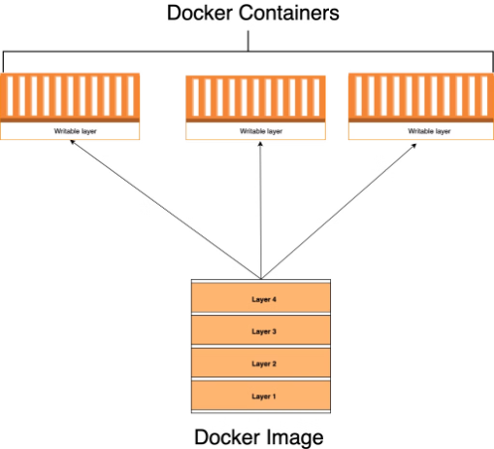
Docker Image
Docker images are read-only templates that contain instructions for creating a container. A Docker image is a snapshot or blueprint of the libraries and dependencies required inside a container for an application to run.

Slide 26

Build an image from a Dockerfile
#Example
docker -t image_name path_to_dockerfile build myapp .
2. List all local images
#Example
docker images
3. Pull an image from Docker Hub
#Example
docker pull image_name:tag

Slide 27
4. Remove a local image
#Example
docker rmi [image_name/image_id]
5. Inspect details of an image
#Example
docker image inspect image_name/image_id
6. Prune unused images
docker image prune
7. Delete/remove all images at a time
docker rmi -f $(docker images -q)
Let's do overview

Slide 28
Container Lifecycle
In the context of Docker, “states” generally refer to the different states that a container can be in during its lifecycle. Docker containers can be in various states at different times, depending on their current status and the actions performed on them
1. Run a named container from an image
#Example
docker run --name container_name image_name:tag
2. List all running containers
docker ps
3. List all containers (including stopped ones)
docker ps -a

Slide 29
4. Stop a running container
docker stop container_name_or_id
5. Start a stopped container
docker start container_name_or_id
6. Remove a stopped container
docker rm container_name_or_id
7. Remove a running container (forcefully)
docker rm -f container_name_or_id
8. Inspect details of a container
docker inspect container_name_or_id

Slide 30
9. View container logs
docker logs container_name_or_id
10. Pause a running container
docker pause container_name_or_id
11. Unpause a paused container
docker unpause container_name_or_id
12. Stop all containers at a time
docker stop $( docker ps -a -q )
13. Delete all containers at a time
docker rm $( docker ps -a -q )
Let's do overview

Slide 31
Docker Volumes
Volumes are the preferred mechanism for persisting data generated by and used by Docker containers. While bind mounts are dependent on the directory structure and OS of the host machine, volumes are completely managed by Docker. Volumes have several advantages over bind mounts:
Volumes are easier to back up or migrate than bind mounts.
You can manage volumes using Docker CLI commands or the Docker API.
Volumes work on both Linux and Windows containers.
Volumes can be more safely shared among multiple containers.
Volume drivers let you store volumes on remote hosts or cloud providers, encrypt the contents of volumes, or add other functionality.
New volumes can have their content pre-populated by a container.
Volumes on Docker Desktop have much higher performance than bind mounts from Mac and Windows hosts.

Slide 32

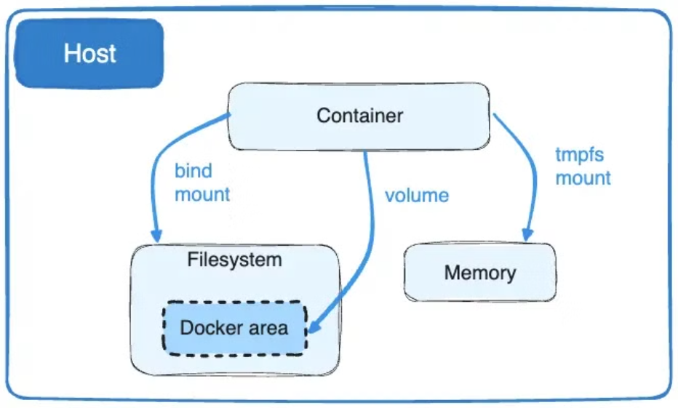
Docker Volume Architecture

Slide 33
Types of Docker Volumes
Anonymous Volumes
Named Volumes
Host Volumes (Bind Mounts)
1. Anonymous Volumes
Anonymous volumes are similar to named volumes, but they do not have a specific name assigned to them. Docker assigns them a unique identifier. These are typically used for temporary storage where the volume’s content does not need to be retained once the container is deleted.
#Example
docker run -it --name <container_name> -v /<directory_name> <image_name> /bin/bash
Real-time Use Case:
Temporary Data Storage: Useful for temporary data that is needed during the container's lifecycle but does not need to persist after the container is removed.

Slide 34
2. Named Volumes
Named volumes are managed by Docker and are stored in a special location on the host filesystem. These volumes are independent of the host directory structure and provide a more flexible and portable way to persist data.
#Example
docker run -it --name <container_name> -v /<directory_name>:<volume _name> <image_name> /bin/bash
Real-time Use Case:
Database Storage: Using named volumes to persist database data ensures that the data remains intact even if the container is re-created or updated.

Slide 35
3. Host Volumes (Bind Mounts)
Host volumes, also known as bind mounts, directly map a directory or file from the host machine's filesystem into the container. This type of volume is useful when you need to share configuration files or other persistent data between the host and the container.
#Example
docker run -it --name <container_name> -v /<directory_name>:<volume _name> <image_name> /bin/bash
docker run -it —name D2 -v /opt/veera:mohan ubuntu /bin/bash
Real-time Use Case:
Development Environment: Developers can edit files on their local machine and immediately see changes reflected in the running container without rebuilding the image.

Slide 36
Share Volumes Container to Container
—> To share volumes to the container we have to use command " --privileged=true --volume -from "
--privileged=true means you are going to giving authorization to access the volume which is available in the container.
--volume -from means where the volume it is available and how we are trying to share the volume
#Example
docker run -it --name <container_name> --privileged=true --volume -from <container_name> <image_name> /bin/bash
Let's do overview

Slide 37
Docker Networks
Docker includes a networking system for managing communications between containers, your Docker host, and the outside world. Several different network types are supported, facilitating a variety of common use cases.
Docker Network Types
Docker networks configure communications between neighboring containers and external services. Containers must be connected to a Docker network to receive any network connectivity. The communication routes available to the container depend on the network connections it has.
1. Bridge Network
2. Host Network
3. None Network

Slide 38
1. Bridge Network
The bridge network is the default network type when you create a container. It allows containers on the same host to communicate with each other while isolating them from containers on other hosts.
Example: Imagine you have a web application consisting of a front-end container (running a web server) and a back-end container (running a database). Using a bridge network, these containers can communicate with each other.
#Create a bridge network
docker network create my_bridge_network
#Run the database container and attach it to the bridge network
docker run -d --name db --network my_bridge_network mongo
#Run the web server container and attach it to the bridge network
docker run -d --name web --network my_bridge_network nginx

Slide 39
2. Host Network
The host network removes network isolation between the container and the Docker host. The container shares the host's networking namespace and can access services running on the host.
Example: Suppose you want to run a containerized application that needs to bind to a specific port on the host.
#Run a container using the host network
docker run -d --network host nginx
3. None Network
The none network disables all networking for a container. This can be useful for containers that do not require network access.
Example: Suppose you want to run a container for a task that does not need any network connectivity, such as a local data processing job.
#Run a container with no network
docker run -d --network none my_data_processing_image

Slide 40
Docker Compose
Docker Compose is a tool for defining and running multi-container applications. It is the key to unlocking a streamlined and efficient development and deployment experience.
Compose simplifies the control of your entire application stack, making it easy to manage services, networks, and volumes in a single, comprehensible YAML configuration file. Then, with a single command, you create and start all the services from your configuration file.
Compose works in all environments; production, staging, development, testing, as well as CI workflows. It also has commands for managing the whole lifecycle of your application:
Start, stop, and rebuild services
View the status of running services
Stream the log output of running services
Run a one-off command on a service

Slide 41
How Compose works
Docker Compose relies on a YAML configuration file, usually named compose.yaml.
The compose.yaml file follows the rules provided by the Compose Specification in how to define multi-container applications. This is the Docker Compose implementation of the formal Compose Specification.
​
The default path for a Compose file is compose.yaml (preferred) or compose.yml that is placed in the working directory. Compose also supports docker-compose.yaml and docker-compose.yml for backwards compatibility of earlier versions. If both files exist, Compose prefers the canonical compose.yaml

Slide 42
Why use Compose?
Key Benefits of Docker Compose​
Using Docker Compose offers several benefits that streamline the development, deployment, and management of containerized applications:
Simplified control: Docker Compose allows you to define and manage multi-container applications in a single YAML file. This simplifies the complex task of orchestrating and coordinating various services, making it easier to manage and replicate your application environment.
Efficient collaboration: Docker Compose configuration files are easy to share, facilitating collaboration among developers, operations teams, and other stakeholders. This collaborative approach leads to smoother workflows, faster issue resolution, and increased overall efficiency.
Rapid application development: Compose caches the configuration used to create a container. When you restart a service that has not changed, Compose re-uses the existing containers. Re-using containers means that you can make changes to your environment very quickly.

Slide 43
Portability across environments: Compose supports variables in the Compose file. You can use these variables to customize your composition for different environments, or different users.
Extensive community and support: Docker Compose benefits from a vibrant and active community, which means abundant resources, tutorials, and support. This community-driven ecosystem contributes to the continuous improvement of Docker Compose and helps users troubleshoot issues effectively.
Common Use Case Of Docker Compose​
Compose can be used in many different ways. Some common use cases are outlined below.
Development Environment​
When you're developing software, the ability to run an application in an isolated environment and interact with it is crucial. The Compose command line tool can be used to create the environment and interact with it.
The Compose file provides a way to document and configure all of the application's service dependencies (databases, queues, caches, web service APIs, etc). Using the Compose command line tool you can create and start one or more containers for each dependency with a single command (docker compose up).

Slide 44
Automated Testing Environment
An important part of any Continuous Deployment or Continuous Integration process is the automated test suite. Automated end-to-end testing requires an environment in which to run tests. Compose provides a convenient way to create and destroy isolated testing environments for your test suite. By defining the full environment in a Compose file, you can create and destroy these environments in just a few commands.
docker compose up -d
docker compose down
Single Host Deployments
Compose has traditionally been focused on development and testing workflows, but with each release we're making progress on more production-oriented features.
For details on using production-oriented features, see Compose in production.

Slide 45

Docker Compose File Reference
Docker Compose File Syntax
version:
Specifies the version of the Docker Compose file format
#Example
version: '3.8'
services:
Defines the services/containers that make up the application.
#Example
services:
web:
image: nginx:latest

Slide 46
networks:
Configures custom networks for the application.
#Example:
networks:
my_network:
driver: bridge
volumes:
Defines named volumes that the services can use.
#Example:
volumes :
my_volume :

Slide 47
environment:
Sets environment variables for a service.
#Example:
environment :
- NODE_ENV=production
ports:
Maps host ports to container ports.
#Example:
ports :
- "8080:80"

Slide 48
depends_on:
Specifies dependencies between services, ensuring one service starts before another.
#Example:
depends_on:
- db
build:
Configures the build context and Dockerfile for a service.
#Example:
build:
context: .
dockerfile : Dockerfile.dev

Slide 49
volumes_from:
Mounts volumes from another service or container.
#Example:
volumes_from :
- service_name
command:
Overrides the default command specified in the Docker image.
#Example:
command : ["npm", "start"]

Slide 50
Lets Work With Real Time Projects
Transaction History
Docker Case Study
THE END

